Slide 1
BONZI CHOCOLATE
Made by : Rebecca & Kye

Slide 2
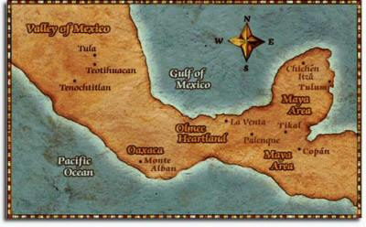
Origins of Cacao
This region's rich tropical rainforests are a primary centre of diversity and it is possible the cocoa tree grew here 10,000 to 15,000 years ago.
Notes:
1900BC Mesoamerica

Slide 3
Harvest Season
Country | Main crop | Mid crop
Brazil | Oct-Mar | Jun-Sep
Cameroon | Sep-Feb | May-Aug
Colombia | Apr-Jun | Oct-Dec
Congo, Democratic Republic | Sep-Mar | Apr-Sep
Costa Rica | Jul-Feb | Mar-Jun
Côte d'Ivoire | Oct-Mar | May-Aug
Dominican Republic | Apr-Jul | Oct-Jan
Ecuador | Mar-Jun | Dec-Jan
Ghana | Sep-Mar | May-Aug
Key points
・5-6months
・twice per year
・Many countries near the Equator

Slide 4
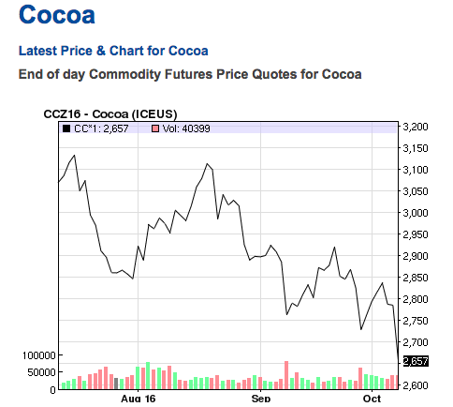
Pricing of Cacao
$2742.7 per kilogram
2,797.87Cocoa beans, US$ per metric tonne
As of: Friday, September 30, 2016
Source: International Cocoa Organization

Slide 5
Challenges for the farmer

Slide 6
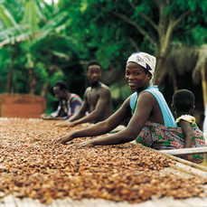
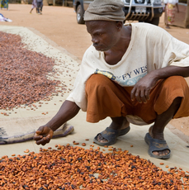
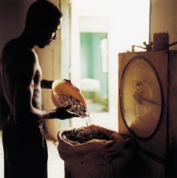
! Low Productivity
・Farmers often have limited knowledge of modern farming techniques and farm management skills as well as limited access to finance that would allow the purchase of input supplies and quality planting material.
・Aging trees, decline in soil fertility and pests and disease that attack cocoa trees.

Slide 7
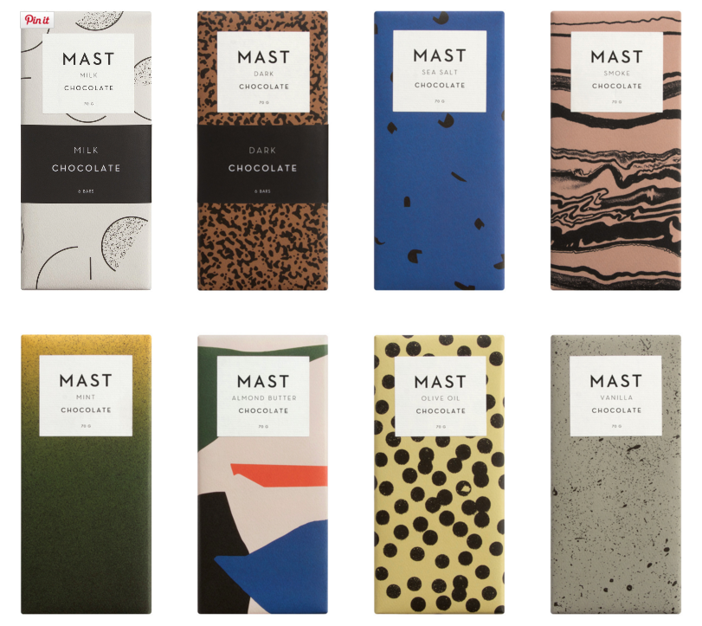
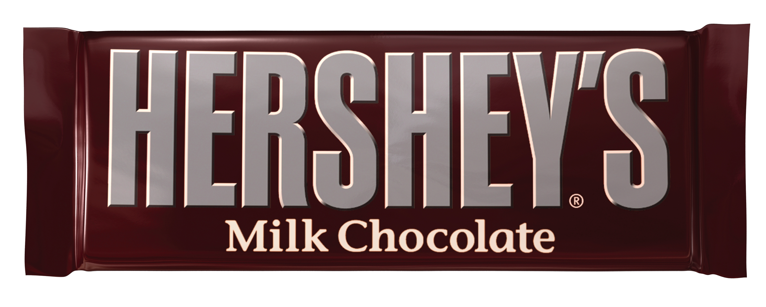
VS
! Marketing Challenges
・The percentage of the world price that farmers receive varies significantly across regions. Reasons: regulatory environment, access to market information, the use of individual sales versus leveraging the power of group buying, understanding of cocoa quality requirements; and transportation costs.

Slide 8
MOST EXPENSIVE CHOCOLATE IN THE WORLD

Slide 9
MOST EXPENSIVE COFFEE IN THE WORLD

Slide 10
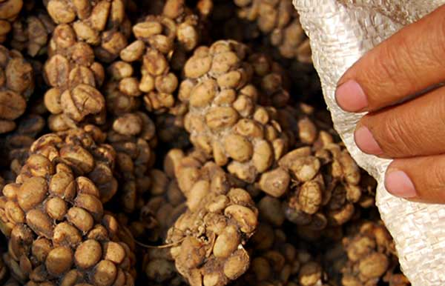

Slide 11
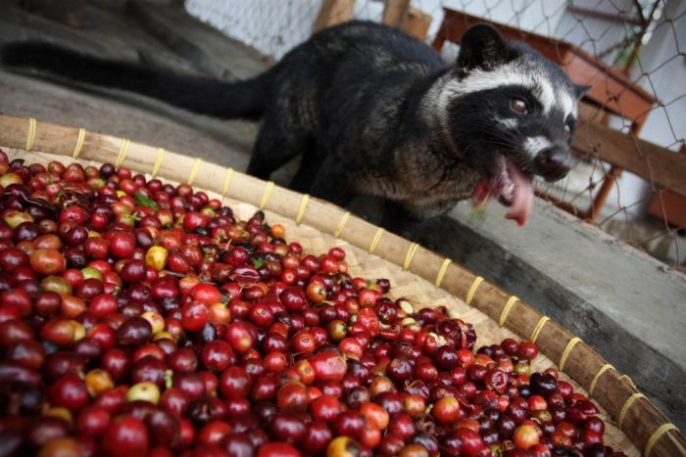

Slide 12
MOST EXPENSIVE CHOCOLATE IN THE WORLD

Slide 13
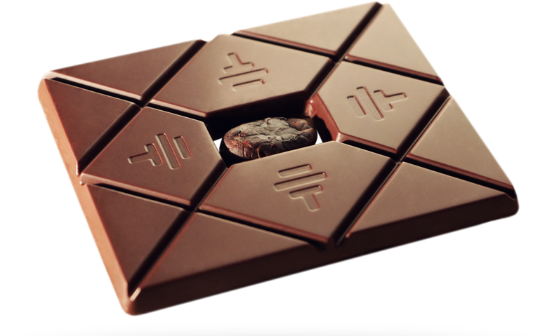
Notes:
this chocolate as it is said to be the world's most expensive bar.
To'ak chocolate, which translated to 'earth' and 'tree' in ancient Ecuadorian dialects, costs a $260 (£169) per bar.
the handmade treat is surprisingly light, in fact it is so delicate that each bar weighs just 1.5 ounces.
A shelled cacao bean is placed in the centre of each bar - this must fit perfectly and measure between 7mm and 8mm

Slide 14
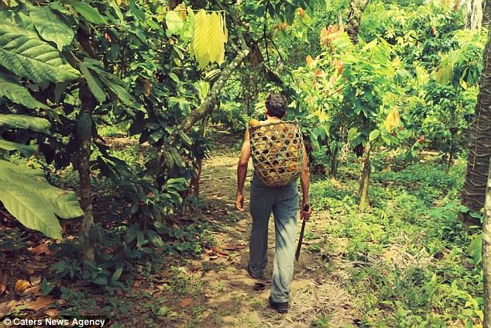
Notes:
Rare cacao seeds are first harvested from the coast of Ecuador in order to create the chocolate bar
95 per cent of chocolate is made using mass-produced beans, whereas their chocolate comes from the remaining five per cent, known as fine grade cacao.

Slide 15
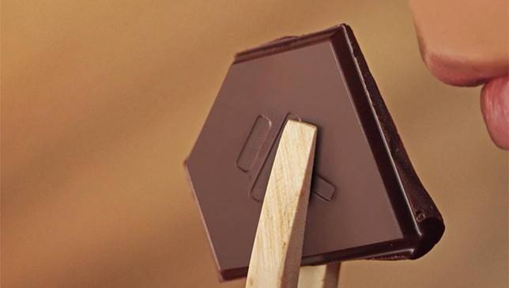
Notes:
The chocolat coutains 81 per cent cacao mass and the rest sugar.
To make this kind of chocolat bar it requires 36 steps before commercialization.
It is eaten using wooden tongs, or tasting utensils, so that it is easier to perceive the chocolate's aroma on the nose.

Slide 16
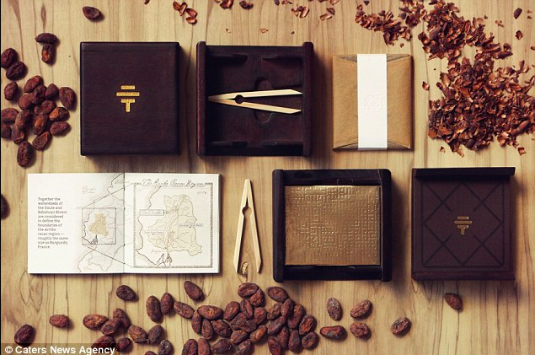
Notes:
The chocolate bar is presented in a wooden gift box complete Arriba Appelation map and wooden tongs.

